Slide 1
Supporting V.I.T.A.L. Faculty
Part-time Faculty Council, March 25th, 2024
Dorothy Marsil
Program Coordinator, Professor
Department of Psychological Science
CFC Chair, RCHSS
Lauren Taglialatela
GenEd Coordinator, Professor
Department of Psychological Science

Slide 2
The importance of being seen.

Slide 3
background
Two presentations to the Chairs and Directors Assembly (CDA) this academic year about supporting V.I.T.A.L. faculty at KSU
Underscore critical impact V.I.T.A.L. faculty have at KSU
Identify challenges that V.I.T.A.L. faculty may face that are different from other faculty at KSU
Identify existing departmental, college, and university services/resources to support V.I.T.A.L. faculty
Identify areas where more support is needed for V.I.T.A.L. faculty
Identify areas where more support is needed to support Chairs/Deans who are supporting V.I.T.A.L. faculty

Slide 4
V.I.T.A.L. Faculty at KSU
Sustained and Significant Roles
Some departments/units rely on V.I.T.A.L. faculty to deliver 40%+ courses
Robust presence in GenEd
Magnified by USG IMPACT Refresh
Sustained enrollment -> Enrollment increase expected
KSU has experienced growth while other universities have not
Increased student demand = More educators needed to create and deliver high-quality classes
Valuable contributions to the KSU -> Workforce pipeline
Bolster USG's and KSU's initiatives to support career-readiness

Slide 5
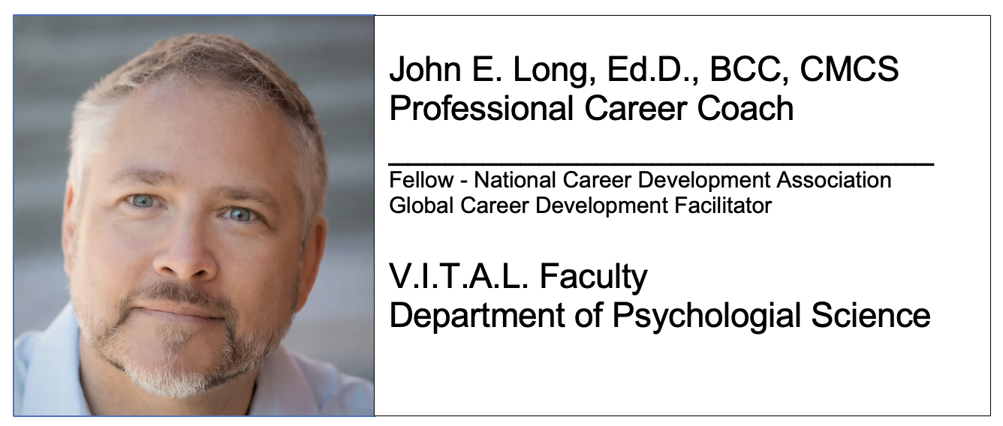
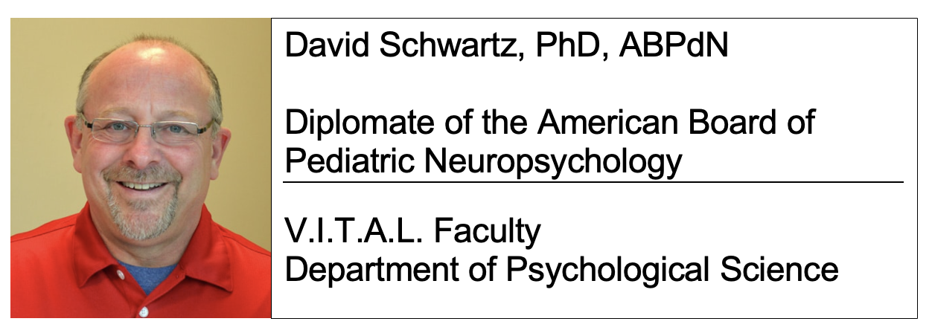
Many V.I.T.A.L. faculty bring real-world career information, perspectives and networking into their classrooms while delivering high-quality educational experiences and opportunities to KSU students.

Slide 6
V.I.T.A.L. Faculty at KSU
Sustained and Significant Presence at KSU
KSU, Fall 2022 (more recent numbers to be available soon)
785 part-time faculty (1352 FT faculty)
58.06% of faculty employed at KSU were part-time
29% of hours taught at KSU were from part-time faculty
Across academic journey this number increases the footprint and import of our PT/LT faculty
https://www.kennesaw.edu/about/index.php#ksuataglance

Slide 7
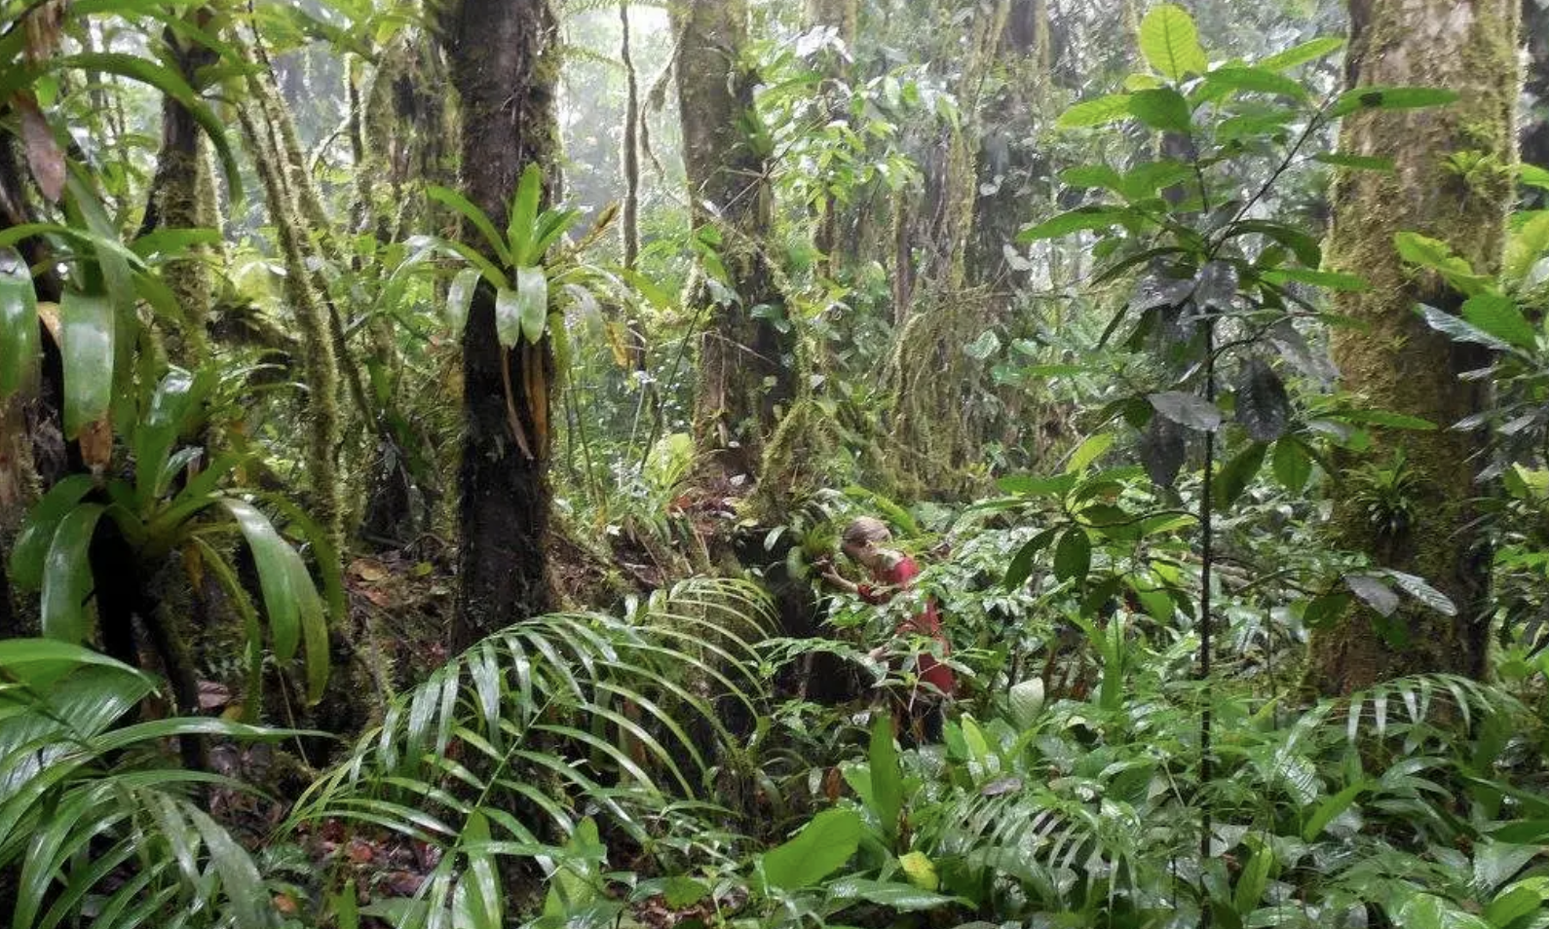
V.I.T.A.L. Faculty
Specific Considerations
All responsibilities are related to quality teaching
This population is dedicated to excellence in teaching
New or returning to KSU after a break
Often managing careers outside of KSU while delivering high-quality classes here
Competing priorities originating outside of KSU
Multiple institutions
Unreasonable expectation to be 100% awash with KSU communications, resources, services, policies
Benefit by clear and consistent messaging and support across the semester

Slide 8
V.I.T.A.L. Faculty
Support of V.I.T.A.L. faculty is Related to Critical Factors
Student Success (especially retention, progression, and graduation (RPG))
Programmatic Success (especially annual program reviews (APR))
Conservation of Limited Resources
On-boarding
High fiscal and personnel costs if there is a revolving door
Need recruitment and retention of high-quality V.I.T.A.L. faculty
Training and Mentoring
Can be high-cost efforts at the Chair/Director and unit levels
May not be possible given current circumstances to provide adequate and consistent training/mentoring

Slide 9
Effective On-boarding & Orientation
Areas that catalyze recruitment,
on-boarding, assimilation, and retention
(ROAR)
of high-quality
part-time and
limited-term faculty.
Sense of Value, Belonging, & Ownership
On-going Needs Based Training & Professional Development
Mentoring/
Evaluation
Meaningful Recognition

Slide 10
Some existing resources
Some of the Existing KSU Support Mechanisms
Tailored Aspects of Orientation
Dedicated position to support PT/LT faculty at CETL
CETL’s Teaching Academy and other support
Digital Learning Innovations (tutorials)
Part-time Faculty Council
V.I.T.A.L. Faculty representation at Faculty Senate
Individual Departments and Units
Example: Department of Psychological Science

Slide 11
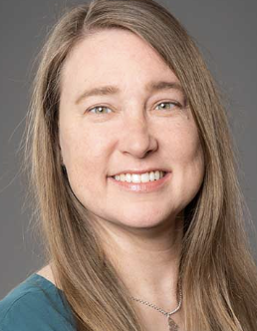
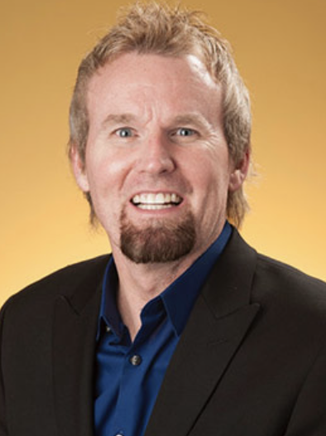
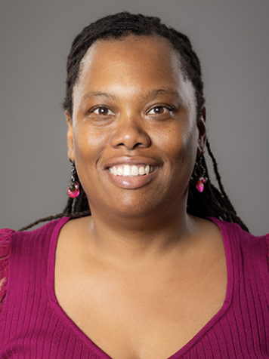
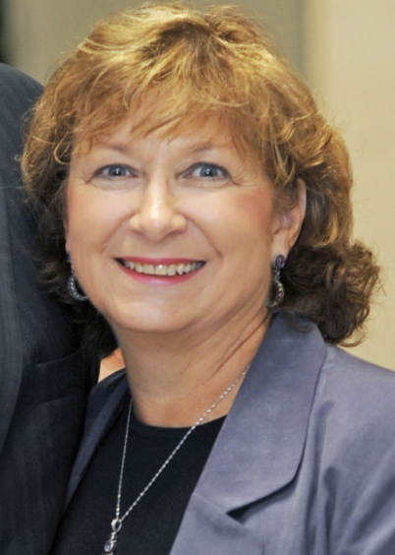
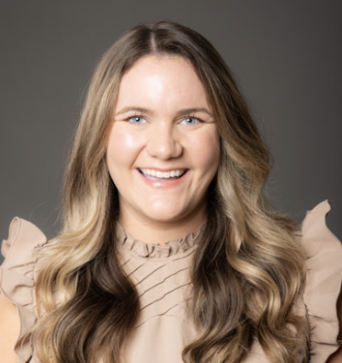
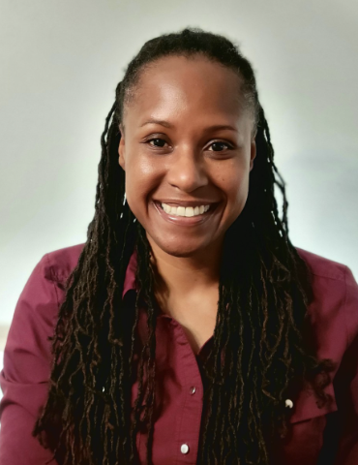
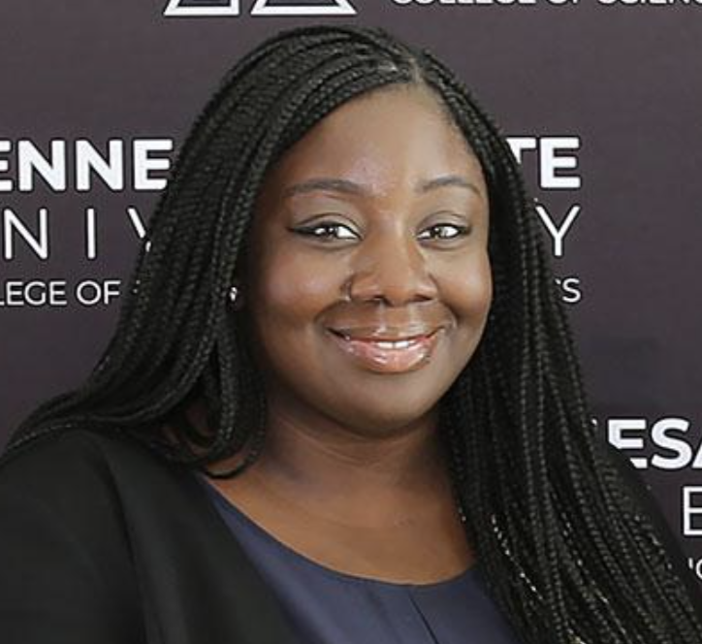
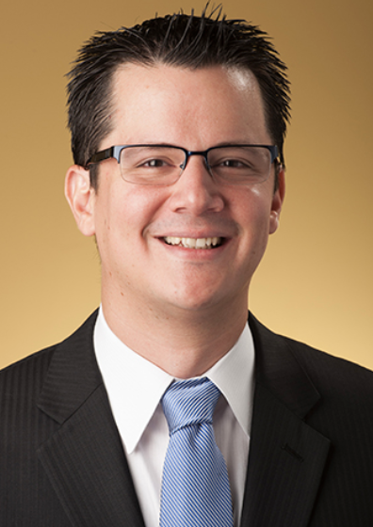
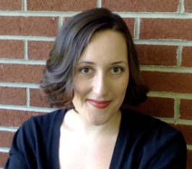
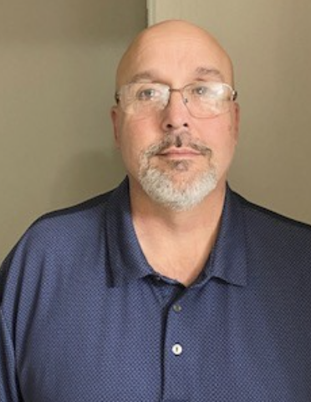

Slide 12
Questions suggestions
Thank You
Dorothy Marsil Lauren Taglialatela
dmarsil@kennesaw.edu ltaglial@kennesaw.edu

