Slide 2
Why Block Scheduling v1.0
F22 National Institute for Student Success (NISS) diagnostic analysis
The KSU Graduation Rate 4 yr. rate ~ 22% 6 yr. rate ~ 48%
Full-time Progression Enrollment: ~30% of KSU students enroll in 15+ c/hrs.
It is an important to:
The USG
Rankings
More qualified &/or discerning applicants in a competitive market
Student debt
KSU faculty, staff, and administration

Slide 3
S22 Actions to Increase RPG
NISS Oversight taskforce
Enrollment Services, Student Success, Faculty Senate, Faculty Gen Ed Director
Areas for Improvement
Data Driven Decisions
Success in Critical Courses
First Year Experience
Advising Coordination
Initial Steps In-Progress
Student Engagement
Data Management Restructuring
Career Planning Stepping Blocks
Mid-term Grades
Faculty development
Course Scheduling (process, software, blocks)

Slide 4
The Goals of KSU Block Scheduling v1.0
RPG
Increase the number of students registered for a full-time (15+ c/hrs.) schedule with the appropriate selection of courses
Minimize the loss of credit if/when students changes majors
Student Engagement to enhance social integration, facilitate the formation of study groups, and foster community building
Registration
Increase pre-registration awareness/understanding of the process and its importance
Modified Advisor involvement & guidance
Streamline for easier enrollment

Slide 5
Which Students are Involved in v1.0?
First-Time-Freshmen (FtF) in the Fall 24 semester
~ 13% of KSU students
~ <20% of course sections
Block scheduling will ONLY be used in the first Fall semester for FtF

Slide 6
Building the v1.0 Blocks
Academic Literature
Benchmarking: NISS, GSU, GPC, CSUF
Solicited College recommendations
Programs of Study
Enrollment Data Analysis & projections
USG Momentum Project
Block scheduling Consultants
Feedback from Colleges (3 iterations)
The Blocks
Major/Interest Block
9-10 c/hrs.
College Specific
Areas B, C, D, E
English/Math Block
6-7 c/hrs.
Delivery Format
Days & Times
Mode (F2F, Online, Hybrid, Mixed)
Campus

Slide 7
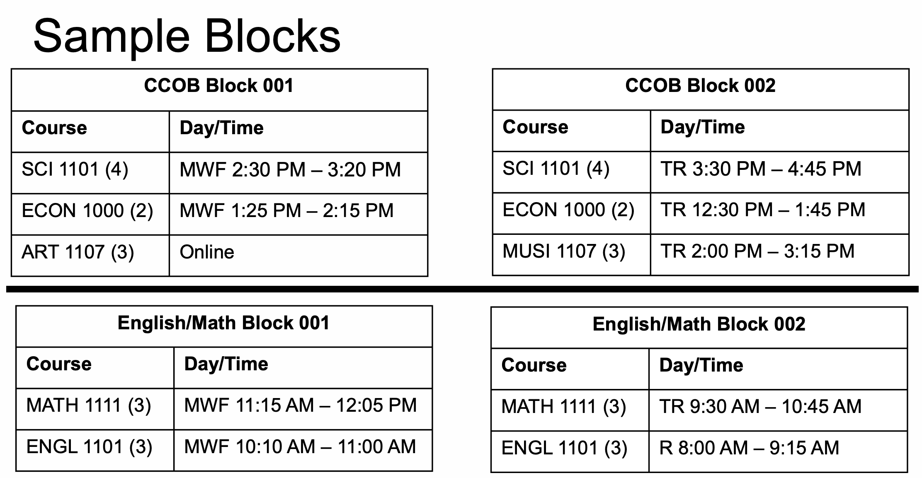

Slide 8
After the Fall 24 Blocks are Built
Colleges build the remaining ~80% of the course schedule and submits:
Time & Location preferences
Faculty assignments
Registrar runs “The Optimizer”
Registrar receives/evaluates requests for schedule modifications

Slide 9
The Registration Process
Pre-Orientation
Info presented via Recruiters, 300+ Tours, and 8 Open Houses
New Student Program videos
Advisor communications & meetings
At Orientation to Add/Drop
Meet with advisors to discuss best path forward (adjust for special circumstances)
Advance Placement credit
Dual Enrollment credit
Part-time students
Athletics
Change of major
Undecided
Other life circumstances

Slide 10
v1.0 & beyond: A Continuous Improvement Process
During the Spring 2024 and Summer 2024 semesters
Continue to monitor the admissions, acceptance and orientation registration data and collaborate with colleges to adjust as needed and possible
Pilot registration process in Spring 2024 with special groups
Fall 2024 Semester
Analyze data
Solicit colleges and other stakeholders for feedback
Continue to work with NISS, consultants and peers for best practices
Build v2.0 draft

